Slide 1
Semi-automated Segmentation Pipeline for Analysis of Knee Joint Kinematics
Wissenschaftliches Werner Kaiser-Sommersymposium
AG Med Phys
A comparision with manual based segmentation
Jena | 12.09.2024 | Aayush Nepal

Slide 2

Motivation
Knee osteoarthritis (OA) affects 10% men and 13% of women aged 60 and older (Zhang et al., 2010)
Altered tibiofemoral kinematics in OA patients can potentially accelerate disease progression (Farrokhi et al., 2014)
Understanding tibiofemoral kinematics is key to assessing knee joint function

Slide 3
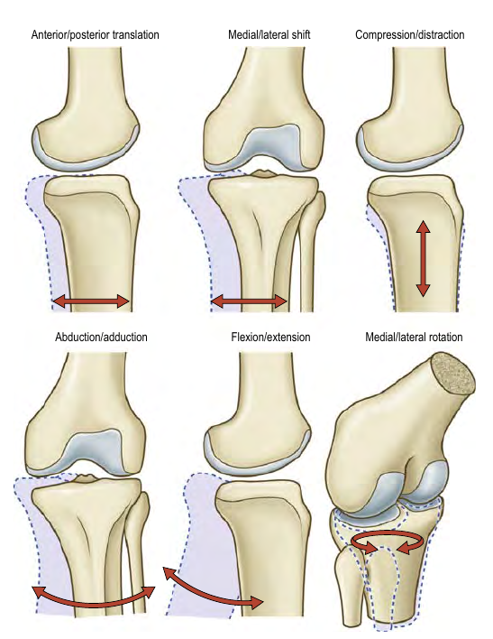
Tibiofemoral kinematics
Six Degrees of freedom
3 Rotations
Flexion-Extension: ~160°
Medial-Lateral: 25-30°
Abduction-Adduction: ~5°
3 Translations
Anterior-Posterior: 5-10 mm
Meidal-Lateral: 1-2 mm
Compression-Distraction: 2-5 mm
(Credit: Gray’s Anatomy 42nd ed.)
Notes:
If we can quantify any one of these motions accurately, then vital information might be revealed.

Slide 6
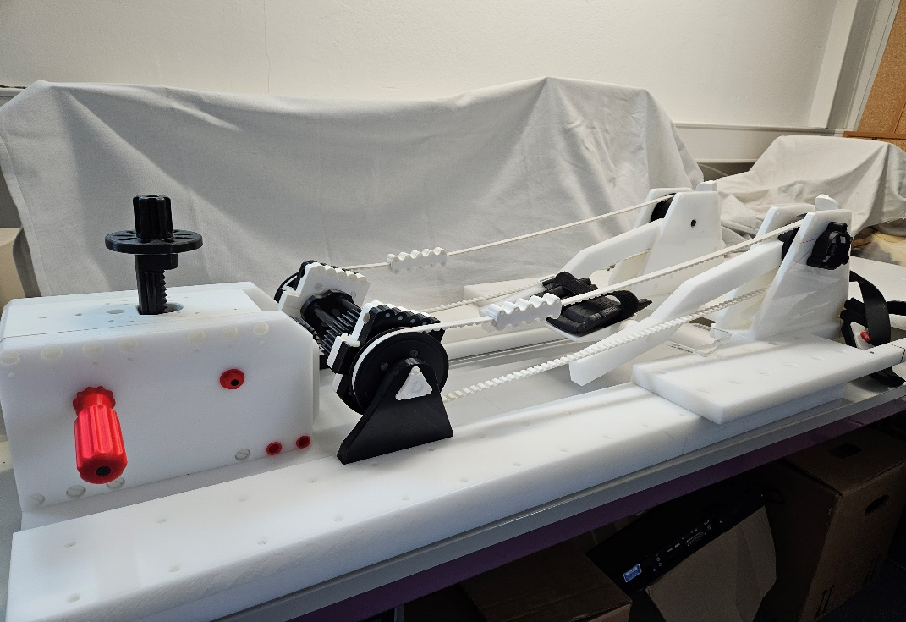
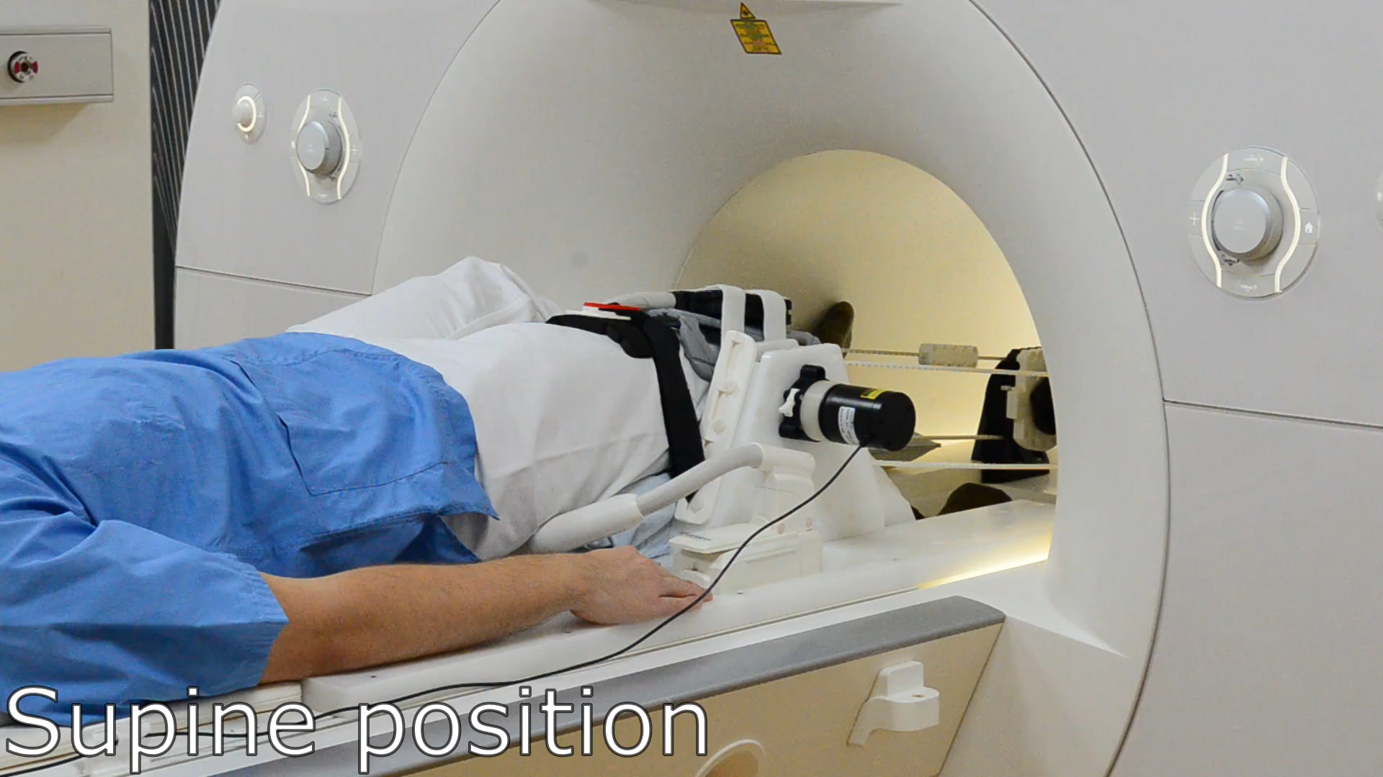

Knee flexion-extension device
Notes:
This device was developed (a few years ago) in collaboration with our partners at Charite Berlin

Slide 7
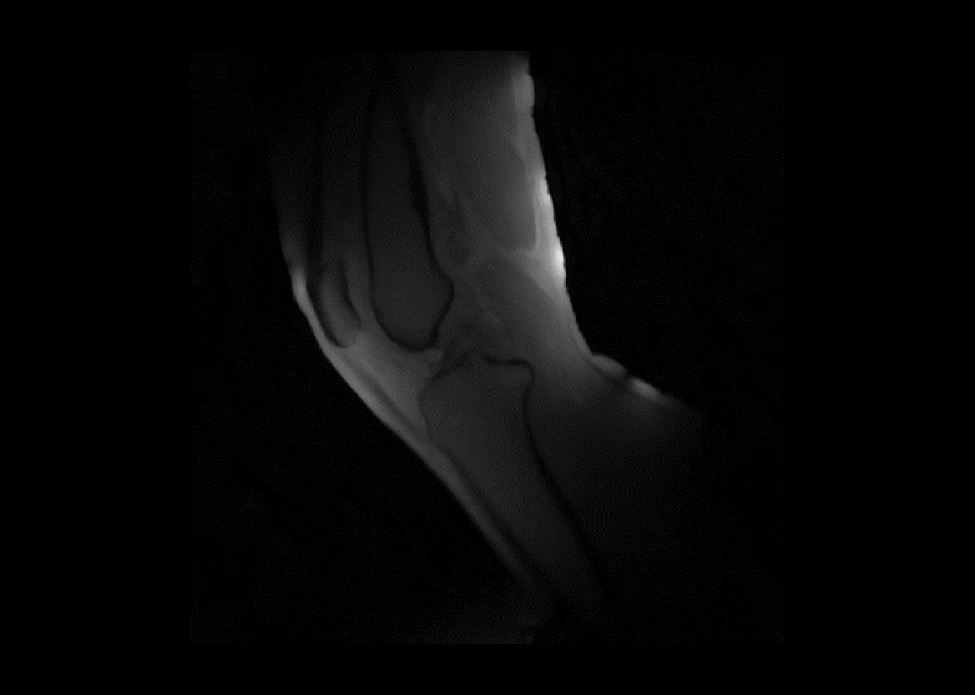
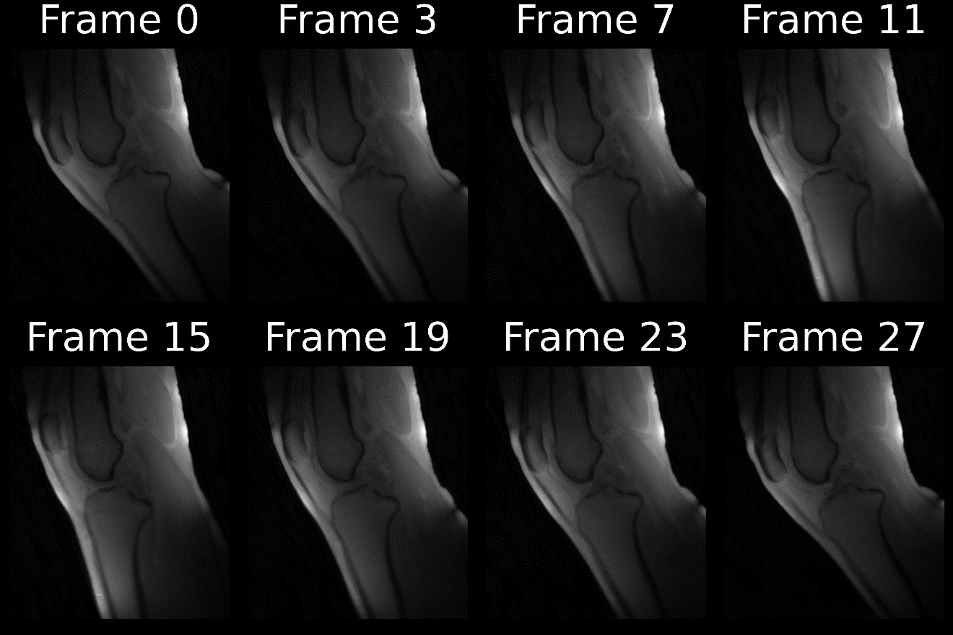
Reconstructed frames

Slide 8
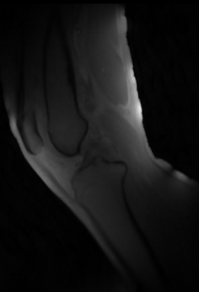
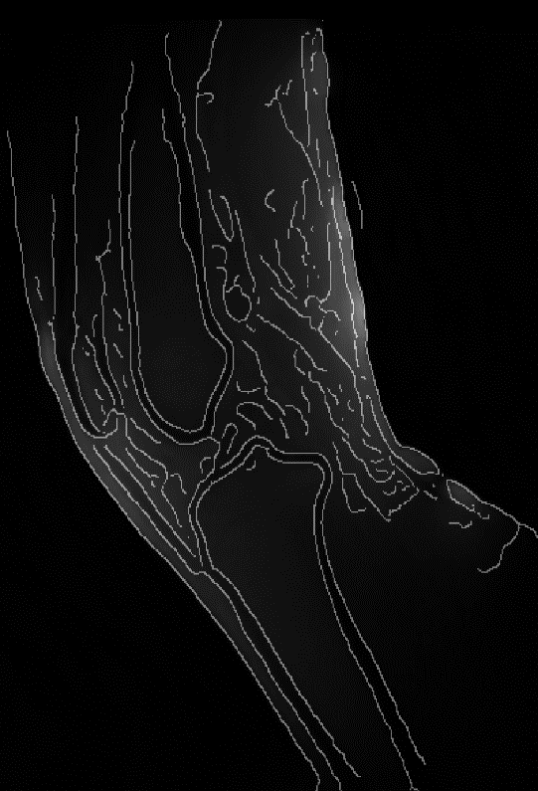
Methods: Edge Detection

Slide 9
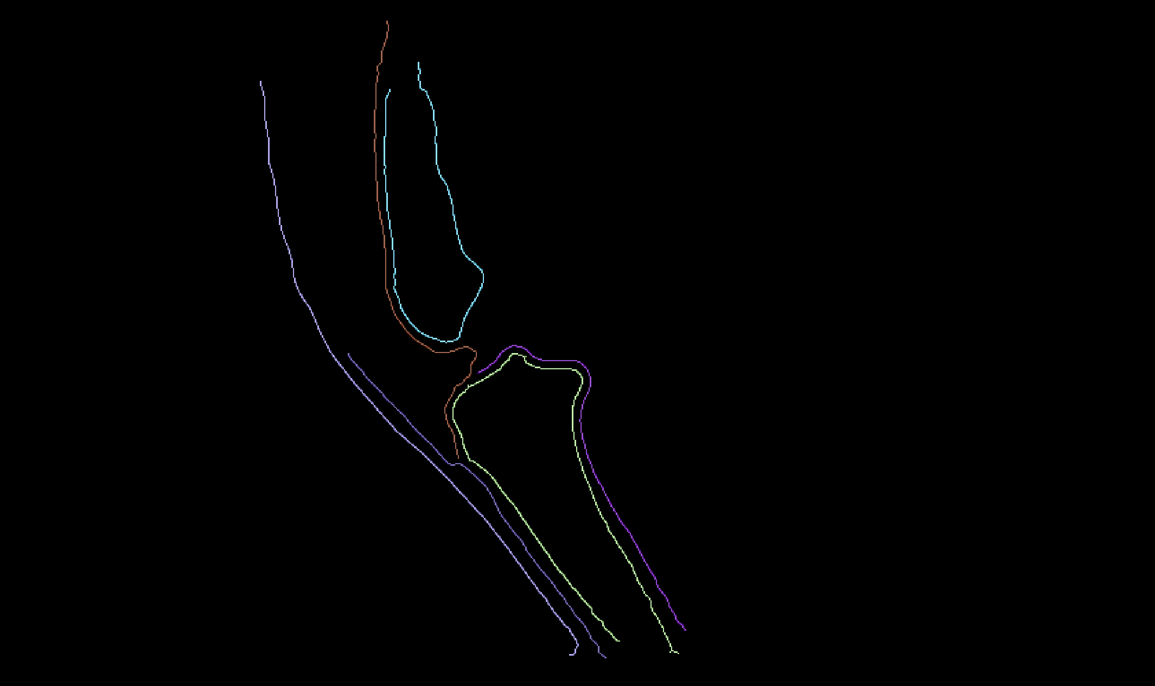
Methods: Connected Component Labelling

Slide 10
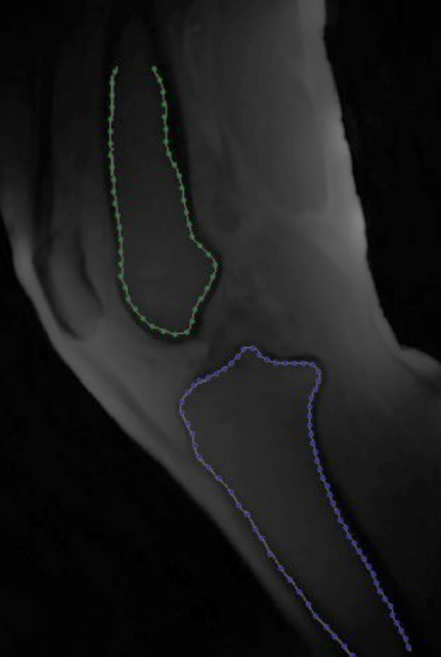
Methods: Downsample and sorting

Slide 11
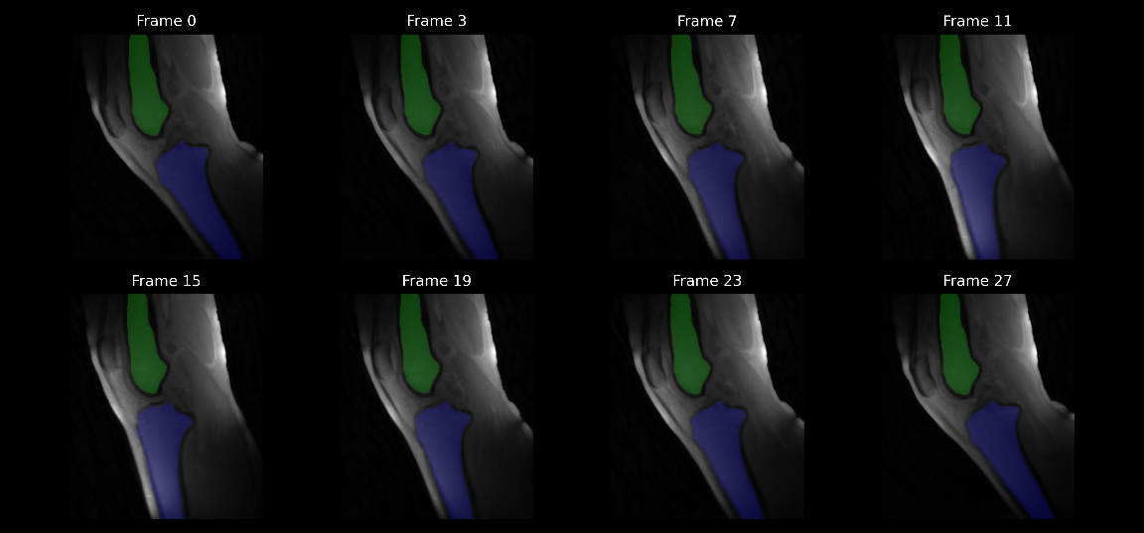
Methods: Applying transformation

Slide 12
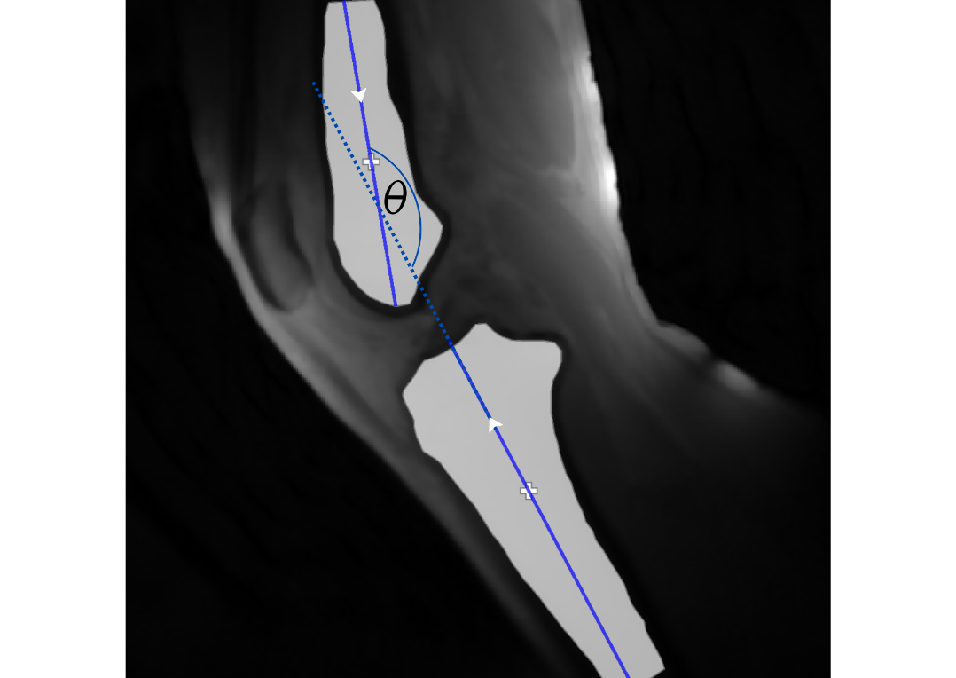
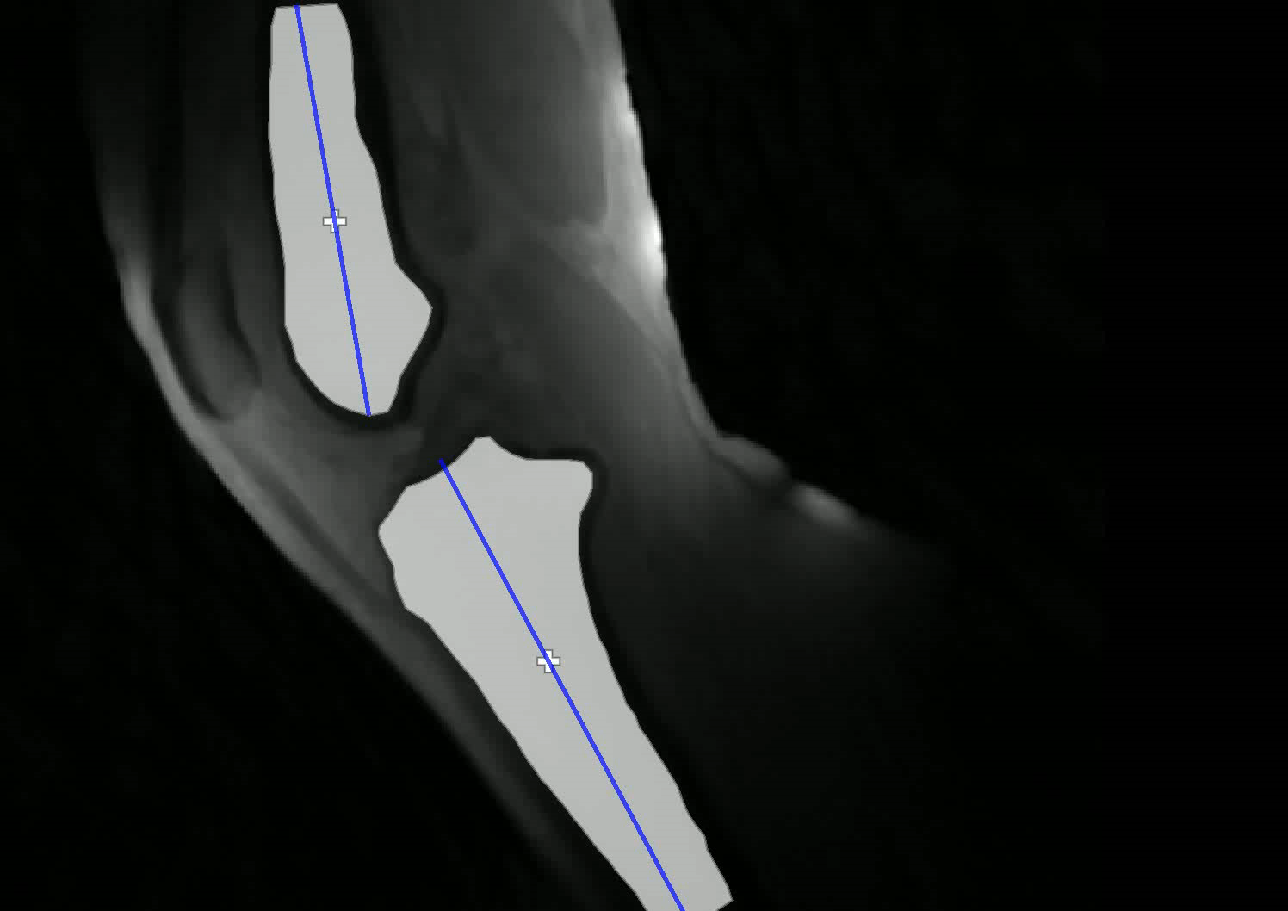
Parameter extraction and tracking

Slide 13
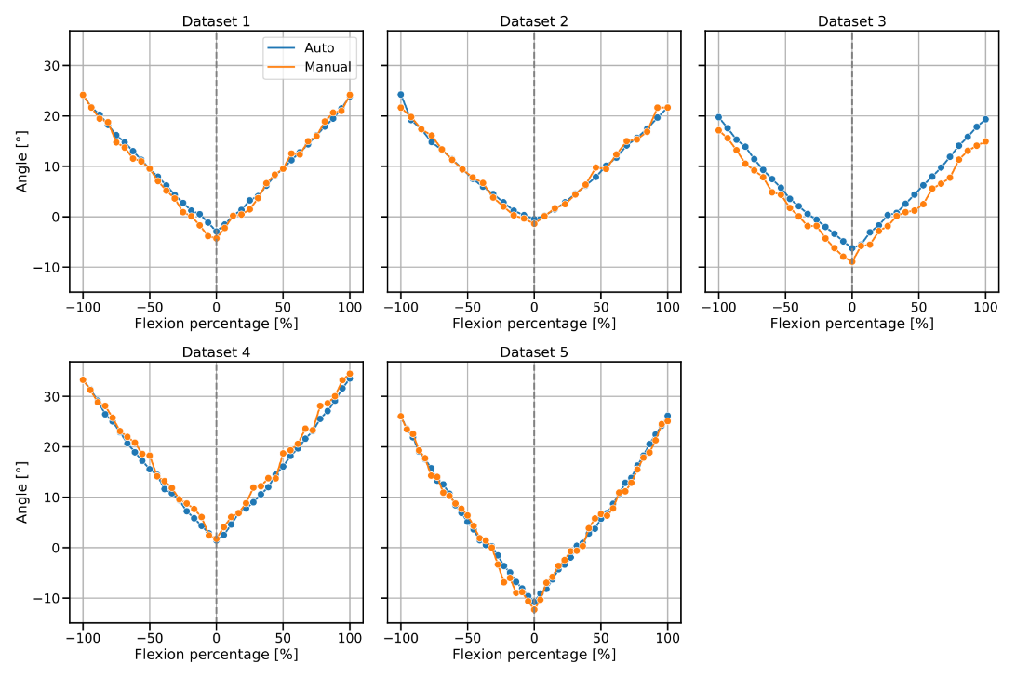
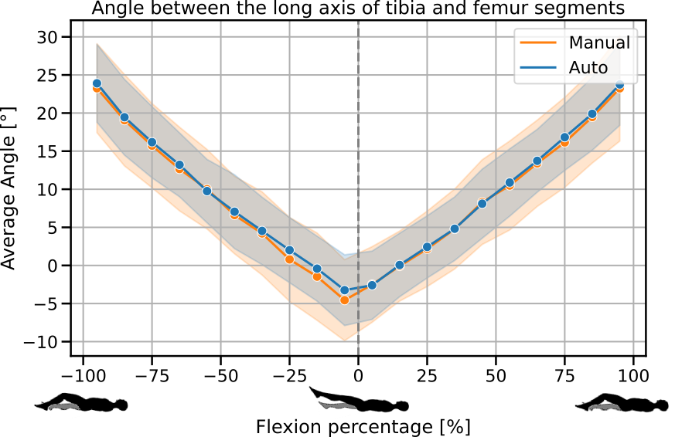
Results

Slide 14
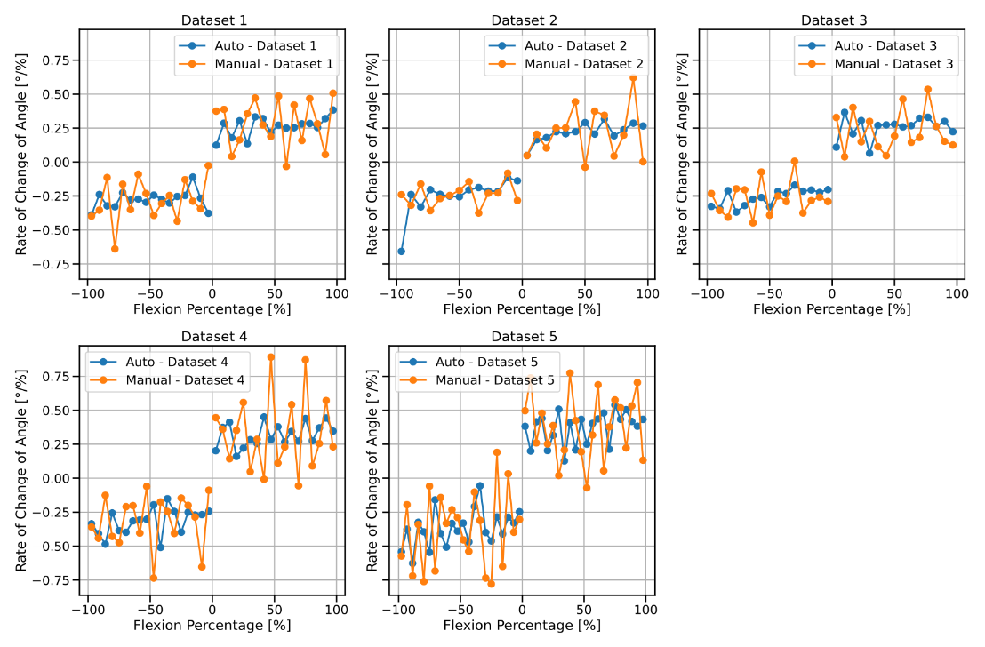
Results

Slide 15
Concluding Remarks

